Slide 1
Cancer Biology Biol 445
Spring 2020
Dr. Heidi Super
Lecture 1
1-15-2020

Slide 2
Announcements
Welcome!
Website
Syllabus
Expectations
General schedule

Slide 3
The textbook dilemma Too little/too much
Course text:
Principles of Cancer Biology Lewis J. Kleinsmith
Short, general audience, good for any science-minded person but may lack some detailed information. (No second edition produced). Lots of current info missing…
Will supplement with material from various sources, including:
Biology of Cancer Robert A Weinberg
Primary literature and reviews
Basic biology/ genetics texts

Slide 4
Tools for the course
Cell biology
Cell parts, cell division, cell cycle
Genetics
Gene expression mechanism—the central dogma!
DNA alterations/mutations
DNA repair
Immunology
Curiosity / Enthusiasm / Time

Slide 5
There’s some biology in here…
“The tumors are made of me. They're made of me as surely as my brain and my heart are made of me. It is a civil war, Hazel Grace, with a predetermined winner.”
~~~Augustus Waters in:
The Fault in our Stars—by John Green

Slide 6
Whadda you know?...
What is cancer?
Who studies cancer?
Who gets cancer?
More or less cancer these days? Why?
Why haven’t we conquered cancer? Will we?
What advances have been made in reducing, treating, curing cancer?

Slide 7
Where should you go for information on cancer?
Many good resources. The National Cancer Institute is probably the best starting place.
Explore: http://www.cancer.gov/

Slide 8
How many people have cancer?
A cancer incidence rate is the number of new cancers of a specific site/type occurring in a specified population during a year, usually expressed as the number of cancers per 100,000 population at risk. That is,
Incidence Rate = (New Cancers / Population) × 100,000
Explore:https://seer.cancer.gov

Slide 9
Cancer seen in 2 ways
1. “Normal” biological phenomenon. Survival of the fittest at a cellular level. Perfect example of evolutionary process.
2. Disease, human suffering, loss.

Slide 10
How have we learned about cancer?
Lot’s of different fields of science have contributed to “cancer research”.
Basically any cell biologist studies at some level, the basics of cancer, by studying cell division.

Slide 11
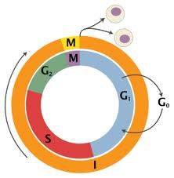

Slide 12
It looks neat and tidy…but how does it work?
What actually pushes a cell from G1 to S?
S to G2? G2 to M?
Can anything stop the cell from dividing?
How does it work?

Slide 13
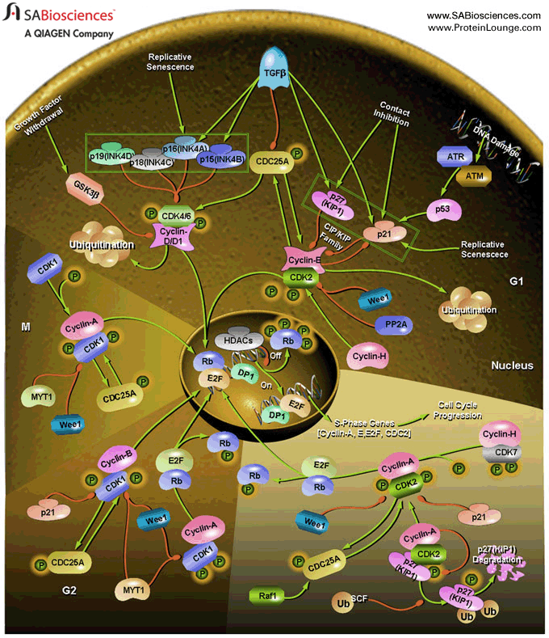
Cell cycle control is complex.
Cancer is disregulated cell cycle control.

Slide 14
First Assignment
Reflection/research on Augustus Waters’s quote----And the name of the book:
The Fault in Our Stars
Please have some notes ready for Friday to share your thoughts.

